Slide 1
SUPPLIER PORTAL

Slide 2
SUPPLIER PORTAL
You can now use a web-based user interface maintained by CGI to create and send electronic invoices to recipients in the City of Kalajoki
Purchase invoices created in and sent through the supplier portal can be addressed to customers of the CGI e-invoicing service, who have offered the supplier portal for the use of their subcontractors and suppliers.

Slide 3
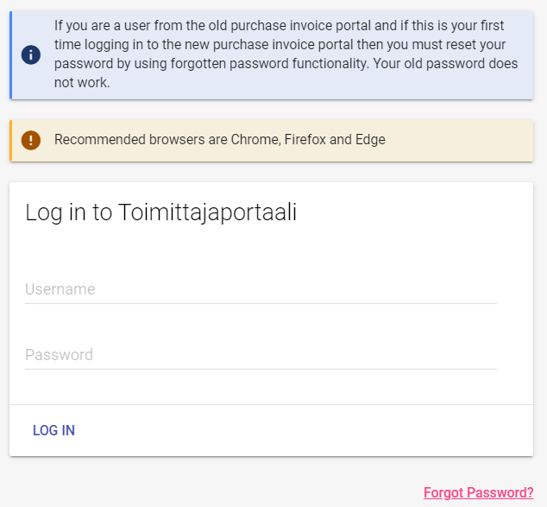
Signing in
The supplier portal is currently incompatible with Internet Explorer. The recommended browsers are Chrome and Firefox.
The portal’s login page is located at (bookmark the address to make it easier to access in the future) https://www.laskuhotelli.fi/portaali/
Use the given password when signing in for the first time and change it immediately in connection with the sign-in process.
The password must be at least 10 characters long and contain upper and lower case letters and numbers. Do not use special characters in your password
If you have forgotten your password, click on the ‘Forgot password’ link.

Slide 4
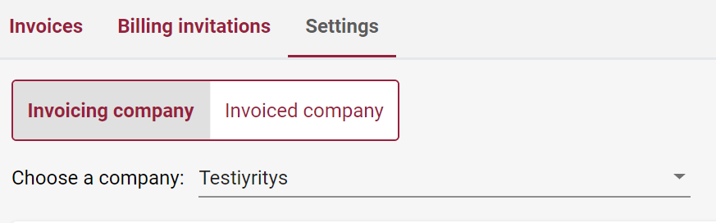

Settings
Start by saving the invoicing company’s/organisation’s/entity’s settings under invoicing company.
By clicking the lock icon, you can edit saved information.
You must enter both the street and postal address for company contact details.
Please make sure to enter all of the required information.
You can edit and update the information (such as an account number) later, if necessary.
Once the information has been saved, click on the ‘Save’ button in the bottom.

Slide 5
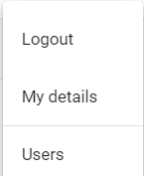
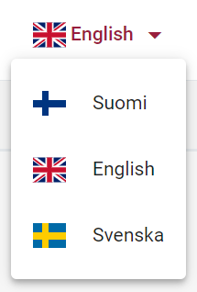
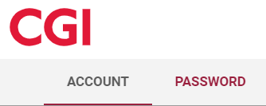
Language settings, user settings, user management
The dark red main menu is located in the top right corner of the screen. Depending on your computer’s settings, the default language may be English. You can change the language setting in the main menu.
The menu that opens when you click on your user name has the following functions:
Logout
My details – personal user information management and password change
Users – user management and administration (adding and removing users)

Slide 6
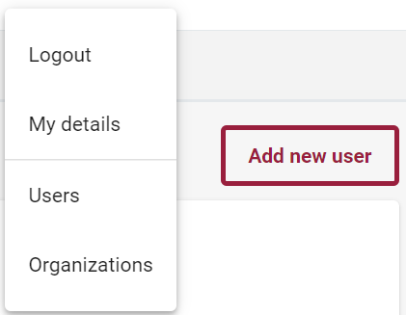
Users
User management is carried out in the ‘Users’ menu.
There, you can create new user IDs for new operators from your company/association.
You can also remove users in the ‘Users’ menu.
It is recommended to add multiple users. In the event of problems, e-mail address changes or personnel changes, it is a good idea to have multiple users so that at least one user’s account always remains operational to manage users and create and send invoices.

Slide 7



Creating an invoice
To create an invoice, first go to the Invoices tab.
Click on the Create new invoice button in the top right-hand corner.
If you have previously saved an invoice as a template, you can select the template from the Use template drop-down menu.

Slide 8

Creating an invoice
The bottom of the Create new invoice page has the following buttons.
Save as draft allows you to save your invoice to edit and send later.
Save as template allows you to use the current invoice as a template when creating new invoices.
Preview as PDF opens a PDF of the invoice in a new tab. To go back, simply select the previous tab.

Slide 9
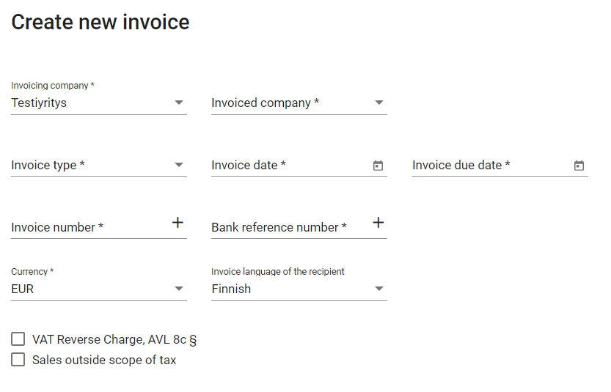
Creating an invoice-Selecting a company to invoice
If there are multiple choices, start by selecting the invoicing company and invoiced company.
The supplier portal can be used to issue invoices to recipients that have adopted the CGI supplier portal for their suppliers.
If multiple invoicing invites have been issued to the same user account, use the Invoicing company menu to select the invoicing company.
The Invoiced company menu includes the companies to which invoices can be sent, such as the City of Kalajoki and all of its subsidiaries.

Slide 10
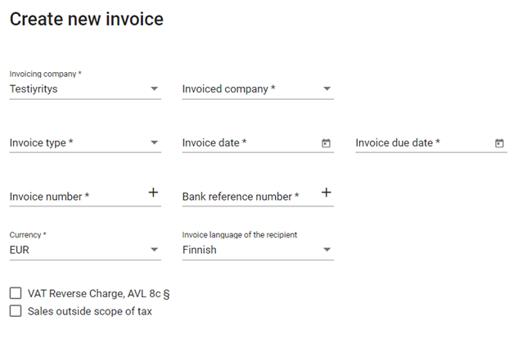
Creating an invoice-mandatory information Compulsory information:
Fields marked with an asterisk are mandatory information.
  Invoicing company
  Invoice type
  Invoice date
  Invoice due date
    The date fields must be filled out in double digits (in DDMMYYY format, e.g. 01.02.2018), select the date in the calendar that pops up from the right side.
  Invoice number
  Bank reference number
  Currency
  What about cost centre, etc. other information from the Finnish instructions – are they still valid?

Slide 11

Creating an invoice - Row-specific additional information
The details of the invoice are saved on invoice rows. You can add more invoice rows using the Add new row button.
You may save row-specific additional information (e.g. delivery date) onto the invoice row in the additional information window that can be opened by clicking the right end of the row.
The entire invoice row can be removed by clicking the trash can icon, if necessary.
Add any additional invoice-specific information in the Free text field. If the delivery date is specific to the invoice, it can also be entered here.

Slide 12
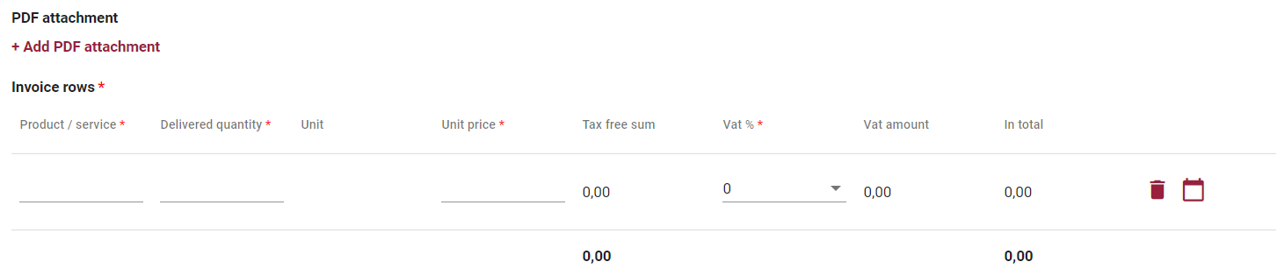
Creating an invoice – invoice rows and attachments
Each invoice must have at least one invoice row, and each row must have all the columns filled in (enter the tax-free price in the Unit price column and the VAT used in the VAT % column; the VAT must be entered even if it is 0%).
You can add a single PDF attachment to the invoice using the Add PDF attachment option.
The maximum attachment size is 2 Mb.
NOTE! The name of the attachment must be short and cannot contain special characters. If you see a validating error message, try to rename the attachment.

Slide 13

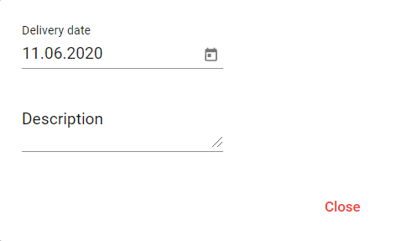
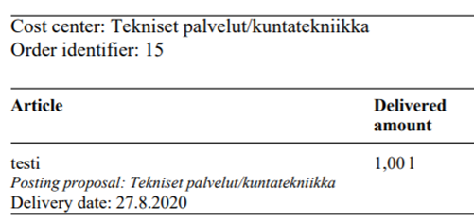
Creating an invoice - Row-specific additional information
You may save row-specific additional information (e.g. delivery date) onto the invoice row in the additional information window that can be opened by clicking the right end of the row.
The entire invoice row can be removed by clicking the trash can icon, if necessary.
These are entered as invoice-specific information in the cost centre and order identifier fields at the top of the invoice.
These are entered as row-specific information in the row’s additional information.

Slide 14
Previewing an invoice
Once all the mandatory invoice information has been entered and saved in the right format, you can preview the invoice by pressing the Preview as PDF button at the bottom of the invoice view. The invoice will open as a PDF in a new browser tab.
If some of the mandatory information is missing or in the wrong format, the text in the field in question will turn red. If this happens, correct the information and try again.

Slide 15
Sending an invoice
To send an invoice, click the Send button at the bottom of the Create new invoice view.
  Remember to send your invoice once it is ready. Only the Send button issues the invoice; simply saving the invoice will not send it to the recipient.
  If any of the information fields turn red, correct the information or its format and try sending the invoice again.
  Also make sure that your invoice is saved on the start page and its status changes to sent.
You can also save an invoice as a template to create new invoices based on it later.
If you cannot complete the invoice in one sitting, you can also save it as a draft and then complete and send it later.

Slide 16

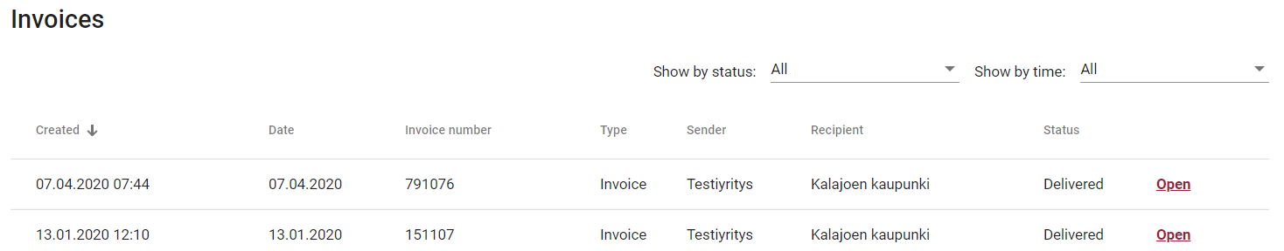
Using previous invoices as templates – completing and sending an invoice saved as a draft
You can copy information from a previous invoice onto a new invoice by selecting the old invoice on the dashboard. The invoice opens as a PDF file. There is a ‘Use template’ button at the bottom of the screen.
If you have saved an invoice as a draft, you can re-open it using the Open button in the right-hand side of the start page. After this, simply complete the invoice and send it.

Slide 17
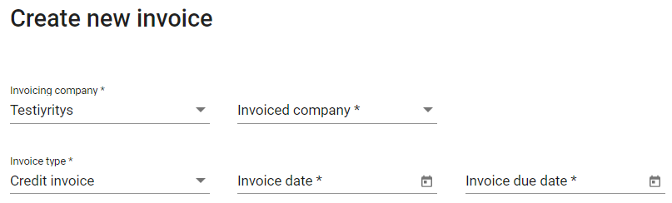
Credit note
The procedure for creating a credit invoice is the same as for creating a normal invoice, but the Invoice type must be changed to Credit invoice.
The delivered quantity is indicated with a minus sign, as a result of which the invoice sum is also negative.

Slide 18
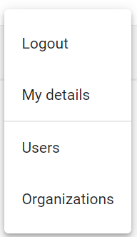
Sign out
Sign out by clicking the main menu.

Slide 19
More information
If you have any questions or need further information or instructions, please contact:
  Office Secretary Sirpa Matkaselkä telephone +358 (0)44 4691 481
  Development and Accounting Manager Jaana Kylmälä telephone +358 (0)44 4691 208
  or e-mail: kalajoki.ostolaskut@kalajoki.fi

Slide 20
THANK YOU!
www.kalajoki.fi

